Slide 1

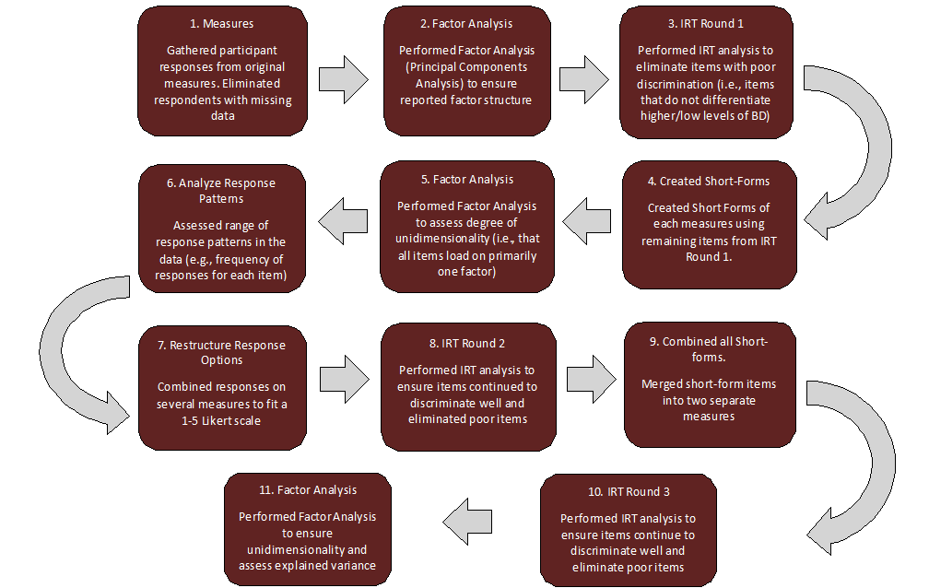
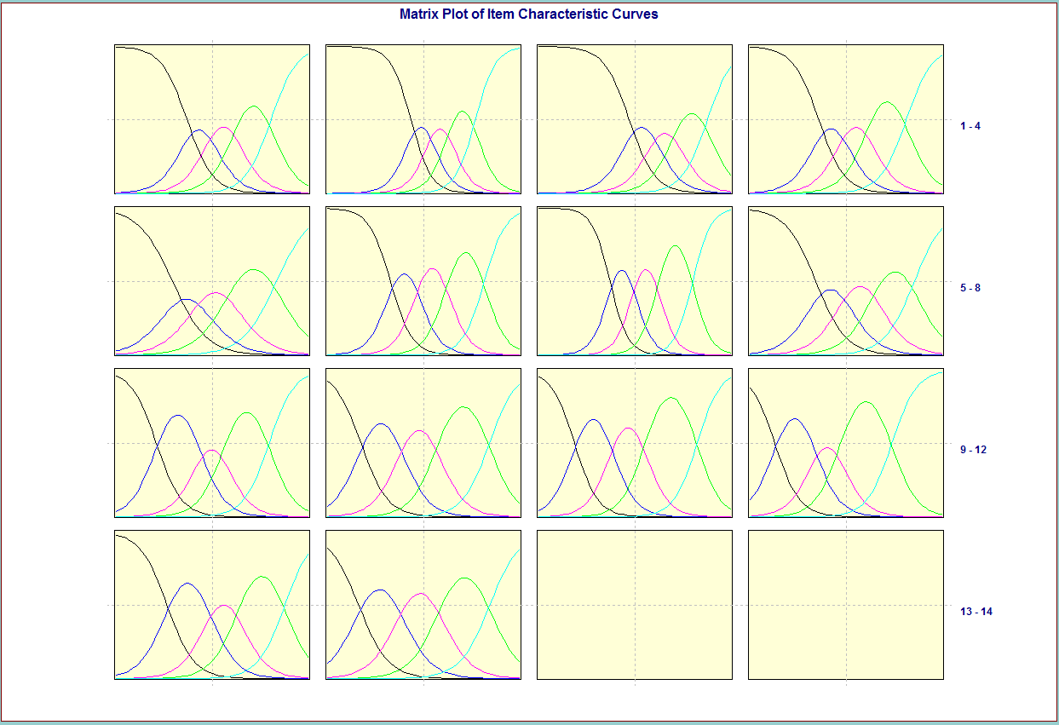
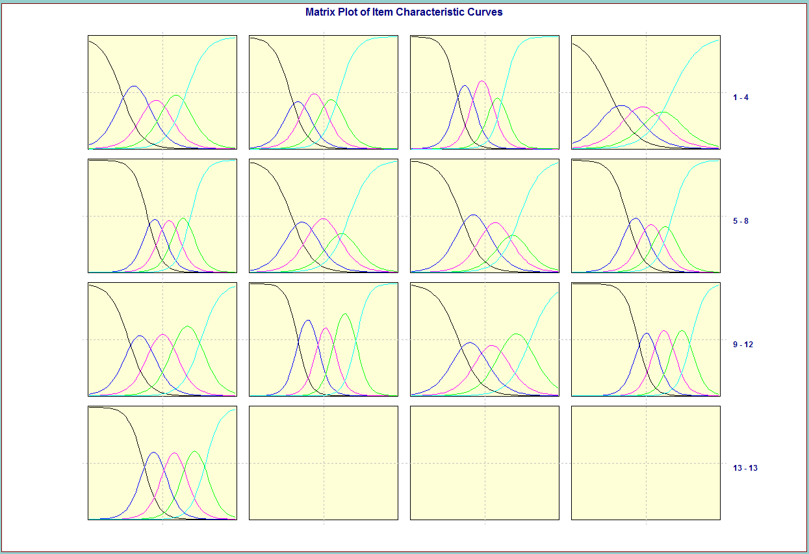
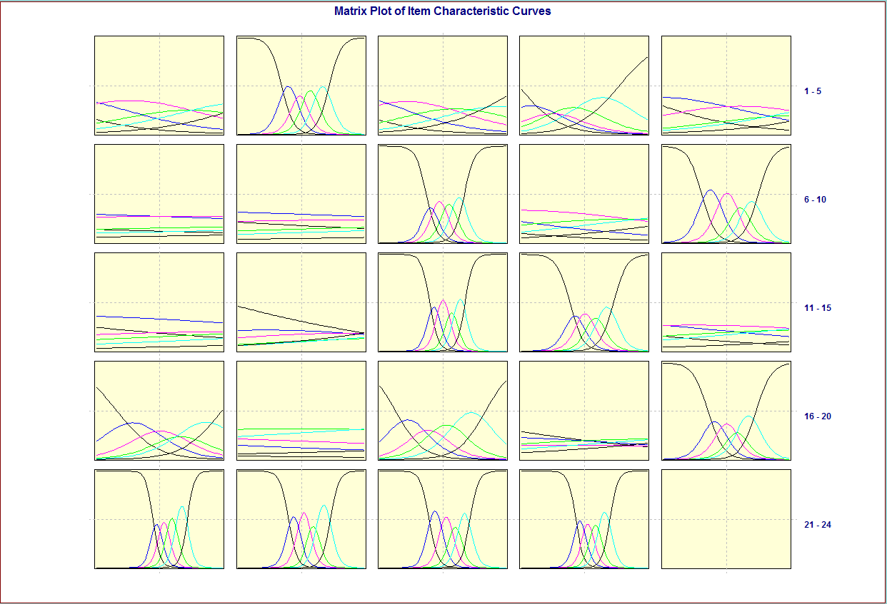
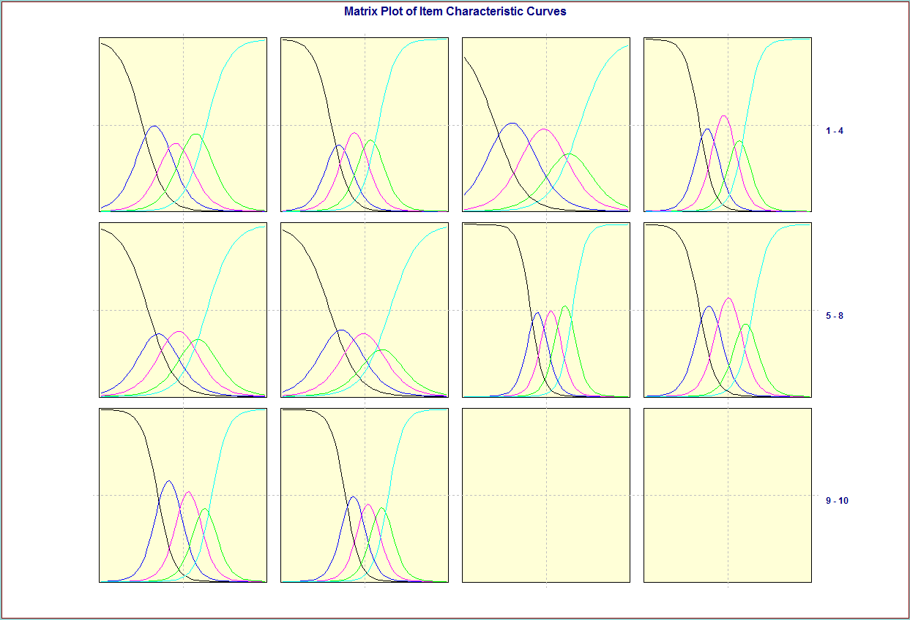
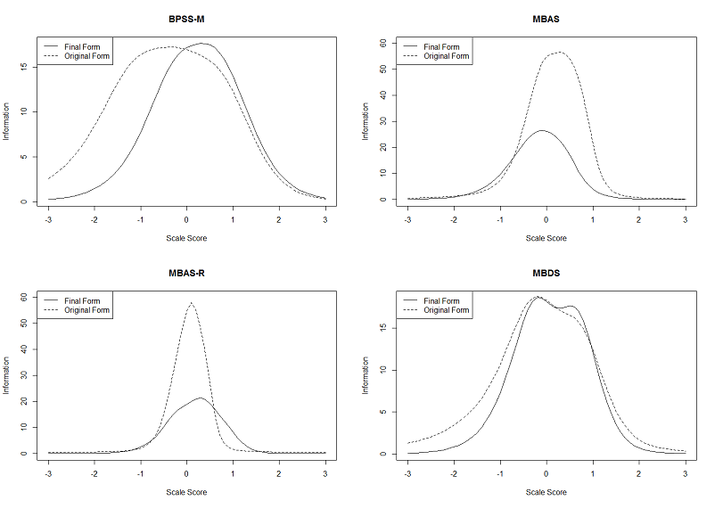
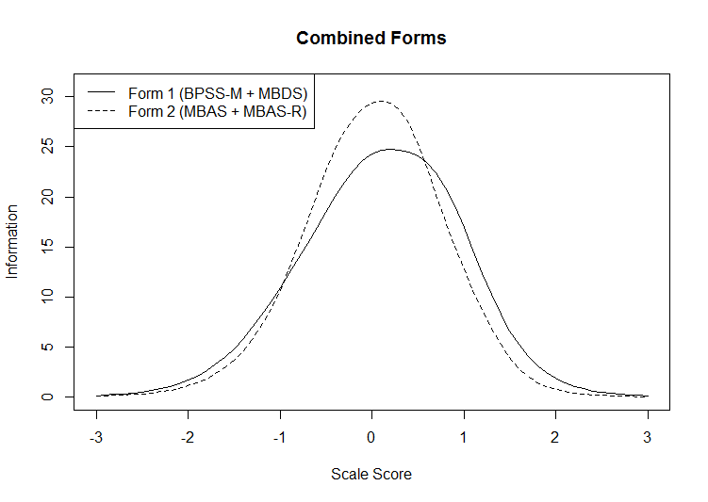
A Psychometric Evaluation of Male Body Dissatisfaction Using Item Response Theory
Marshall T. Beauchamp¹, Erin M. Buchanan, Ph.D.¹, Cynthia E. Brown²
¹Department of Psychology, Missouri State University, Springfield, MO
²Department of Psychological Sciences, University of Missouri-Columbia, Columbia, MO
INTRODUCTION
RESULTS
Body dissatisfaction (BD) is characterized as a person’s negative thoughts or feelings about his or her body, including body shape and size¹. BD has been shown to play a significant role in the development and maintenance of disordered eating (e.g., food avoidance, bingeing, purging) and eating disorders². Given that disordered eating sequelae are linked to severe psychological and physiological disturbances (e.g., depression, suicidality, gastrointestinal conditions), accurate measurement of BD is imperative.
Despite an increase in body image research in recent decades, researchers have focused predominantly on female BD³. Subsequently, there is a greater understanding of development, consequences, and measurement of female BD compared to male BD. Many measures of BD are not sensitive to core features of male BD (e.g., muscularity and bulk), and are insufficient tools to capture this process. Reliable and valid assessment in male populations is especially important, given that male BD has increased exponentially in recent years⁴. Therefore, this study will provide a psychometric evaluation of four currently used measures of male BD using item response theory (IRT).
Figure 4.
ICC Matrices of Combined Forms
CONCLUSIONS
1) Discriminability of each item was assessed and poor items were eliminated
2) Items appeared to be answered consistently across males, with several response patterns collapsed due to low response frequency
3) Short forms were created for each measure, with two additional forms created by combining all items and reanalyzing patterns with IRT and PCA
4) Preliminary findings suggest CAT option possible for these measures
Figure 1.
Flowchart of Methodology and Analyses
METHODS AND PARTICIPANTS
841 Participants were recruited through two sources: 1) MSU’s psychology department undergraduate participant pool (N=391) and 2) Amazon’s Mechanical Turk (MTurk) website (N=450). This two-phase process ensured a sample with heterogeneous demographic qualities. M_{age}= 26.05 (SD = 9.32). The sample was comprised of 81.0% Caucasians, 5.6% African Americans, 5.6% Asians, 3.7% Hispanics, 2.6% Mixed, and 1.7% other.
Participants completed a battery of measures focusing on male body dissatisfaction. The measures included the Male Body Attitudes Scale (MBAS), its revised form (MBAS-R), the Body Parts Satisfaction Scale for Men (BPSS-M), and the Male Body Dissatisfaction Scale (MBDS). Completion of measures, consent, and debriefing took approximately 13 minutes. Participants from MTurk were compensated $1.00 upon completing the task.
FUTURE DIRECTIONS
Though this study presents certain strengths, it is certainly not without limitations or room for future iterations. While we present two new forms of measures with items that appear to work well together in discriminating across various levels of male BD, a continuation of analyses using traditional test theory (e.g., confirmatory factor analysis) should ensure sound psychometric properties (e.g., that these measures continue to emphasize the core features of male BD). Additionally, these data were collected from a non-clinical population. Our current methodology should be replicated within a clinical population to ensure applicability to those with body image issues and eating disorders.
Figure 2.
Item Characteristic Curves (ICC) Matrices for MBAS Original and Short Form
ANALYSES AND STUDY QUESTIONS
IRT methodology (Graded Response Model; GRM) was used to reveal pattern in item responses in the study sample. Analyses examined the following research questions:
What is the discriminability of each item for participant scores?
Are items consistently answered across males?
Are these scales equivalent measures of body dissatisfaction, and, if not already present, are equivalent short-form measures possible?
Is it possible to develop a computer-adaptive test (CAT) short form using items from these measures?
REFERENCES
¹Grogan, S. (2008). Body image: understanding body dissatisfaction in men, women and children. (2nd ed.) New York: Routledge.
²McCabe, M. P., & Ricciardelli, L. A. (2004). Body image dissatisfaction among males across the lifespan: A review of past literature. Journal of psychosomatic research, 56(6), 675-685.
³Cafri, G., & Thompson, J. K. (2004). Measuring Male Body Image: A Review of the Current Methodology. Psychology of Men & Masculinity, 5(1), 18-29.
⁴Bardone-Cone, A. M., Cass, K. M., & Ford, J. A. (2008). Examining body dissatisfaction in young men within a biopsychosocial framework. Body Image,5(2), 183-194.
Figure 3.
Test Information Curves For Separate and Combined Forms
Questions? Contact: Marshall Beauchamp(marshallbeauchamp@gmail.com) or Erin Buchanan (erinbuchanan@missouristate.edu)

